Slide 1




Chart Interpretation
How to analyze and describe charts in the guided writing task
Presented by : Mohamed Jaffel
Under the supervision of : Kamilia Dhifallah

Slide 2
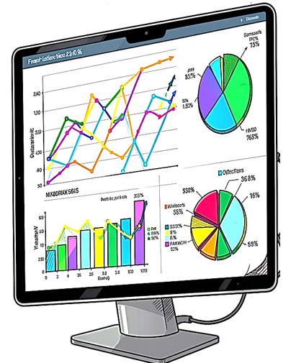
Table of Contents
01
Language Components for Chart Interpretation
02
Sample Pie Chart : AI Use by Teenagers
03
Sample Bar Graph : Pollution Levels
04
Sample table
05
Conclusion and Key Takeaways

Slide 3
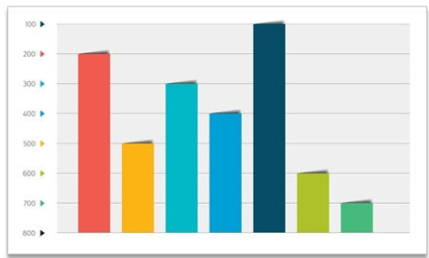
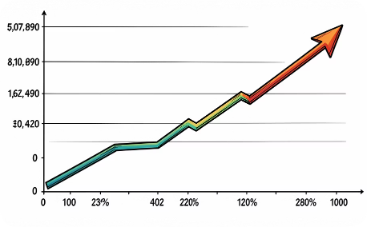
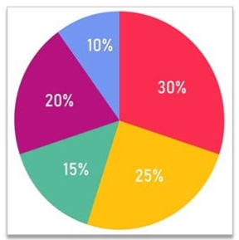
Chart Types
All linkers and expressions can be adapted to these visual formats:
Student Age Group | Video Lessons (Weekly Minutes) | Interactive Quizzes (Weekly Minutes) | Discussion Forums (Weekly Minutes) | Final Course Completion Rate (%)
Teens (13–17) | 180 | 95 | 15 | 45%
Young Adults (18–25) | 120 | 60 | 40 | 68%
Adults (26–45) | 90 | 45 | 75 | 82%
Seniors (46+) | 110 | 30 | 80 | 78%
Bar Graphs
Line Graphs
Pie Charts
Table

Slide 4

Three Main Chart Types
Pie Charts
Bar Graphs
Tables
Show proportions and percentages of a whole.
Display how different parts make up the total.
Show comparisons and trends across categories or time.
Highlight differences between items.
Show precise raw numbers
and detailed structured data.
Display how different facts
are sorted across rows and columns.

Slide 5
Chart Vocabulary
🟦 Upward Movement (↗) | 🟥 Downward Movement (↘) | ⬜ No Change / Variation (→)
Verbs: • Rise / Climb • Increase / Grow • Go up / Leap • Boom / Surge • Soar / Rocket /peak at | Verbs: • Fall / Drop • Decrease / Decline • Reduce / Dip • Plummet / Plunge • Slump | Verbs: • Remain stable • Stay steady / constant • Maintain the same level • Stand at
Nouns: • A rise / An increase • A growth / A surge • Reach a peak of • A boom | Nouns: • A fall / A drop • A decrease / A decline • A reduction / A slump • A plunge | Sentence Examples: • The number of engineers leaving the country peaked at 3,900 in 2026. • Fuel prices fluctuated wildly before staying constant.
Preposition tip: Use to for the final value (rose to 50%) and by for the amount of change (rose by 10%).

Slide 6


Proportions
Quantities
majority, minority, significant portion, nearly half, approximately
substantial, negligible, considerable, marginal, dominant

Slide 7
Describing the Speed of Change
Quick Change
Slow Change
Unexpected Change
Adjectives: rapid, quick, sharp, swift, steep
Adverbs: rapidly, quickly, sharply, swiftly, steeply
Adjectives: steady, gradual, slow
Adverbs: steadily, gradually, slowly
Adjectives: sudden, unexpected, abrupt
Adverbs: suddenly, unexpectedly, abruptly
Example: "Prices rose sharply in 2020" or "There was a gradual decline in …over the decade."

Slide 8
Describing the Degree of Change
Pair an adjective with a noun, or an adverb with a verb, to show how large a change is.
Degree
Adjective
Adverb
Very extensive
dramatic, huge, enormous,
tremendous
dramatically, enormously, tremendously
Extensive
substantial, considerable, significant, remarkable
substantially, considerably, significantly, remarkably
Average
noticeable, marked, moderate
noticeably, markedly, moderately
Small
slight, small, minimal
slightly, minimally
Example: "There was a dramatic increase in …" (adj. + noun) or "Sales increased dramatically" (adv. + verb).

Slide 9



Linking Words and Transitions
Adding Information
Besides, Furthermore, Moreover, In addition, Additionally
Contrasting
However, But, Yet, In contrast , On the contrary On the other hand, Whereas
Showing Results
As a result, Therefore, Consequently, Thus
Sequencing
Firstly, Secondly, Finally, Meanwhile

Slide 10
More on Comparing & Contrasting Data
Similarities
Differences
X is the same as Y
Both X and Y are… / X as well as Y…
Neither X nor Y…
There are many similarities between X and Y
X is more/less + adjective + than Y
Unlike X, Y is… / Contrary to X, Y is…
X is… whereas/while Y is…
Compared to X, Y is… / On the one hand… on the other hand…

Slide 11

Language used for Interpreting a Table
The table shows/reveals/indicates that…/ illustrates / presents data on…/ details/ provides information regarding…
The rows classify... while the columns indicate...
Comparing numbers across columns and rows,…
According to the table, roughly 20% of…
If we look through the table, we notice/conclude that…
There seems to be a significant difference between…
As shown in the table
In contrast to row 1, row 2 displays a downward trend.
The highest value is recorded in the third column.
To summarize the data, Cells X and Y account for the lowest ...
To conclude, the table highlights a significant gap between...
It is evident from this dataset that...
Student Age Group | Video Lessons (Weekly Minutes) | Interactive Quizzes (Weekly Minutes) | Discussion Forums (Weekly Minutes) | Final Course Completion Rate (%)
Teens (13–17) | 180 | 95 | 15 | 45%
Young Adults (18–25) | 120 | 60 | 40 | 68%
Adults (26–45) | 90 | 45 | 75 | 82%
Seniors (46+) | 110 | 30 | 80 | 78%
Always cite specific figures when referring to a table

Slide 12


Sample Tasks
1
Examine the axes
The horizontal axis shows categories, while the vertical axis shows values.
2
Identify highest and lowest bars
Find which category has the maximum value and which has the minimum value.
Examine the bar graph carefully
3
Note the units of measurement
Check what units are used (e.g., units, percentages, dollars) to describe the data accurately.
4
Look for patterns or differences
Observe any significant increases, decreases, or notable differences between categories.

Slide 13
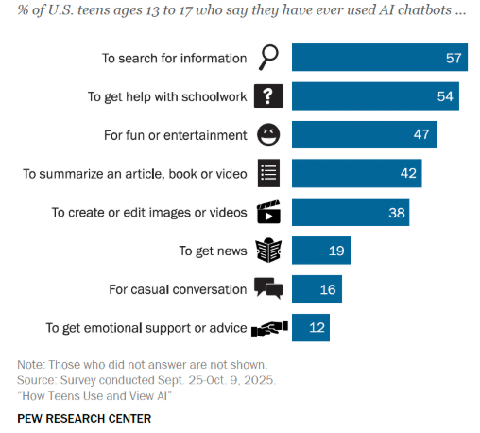
How American teens use and view AI ?

Slide 14
The Bar Graph : How Teens Use AI Chatbots
This paragraph interprets the bar graph data showing the specific purposes for which teenagers turn to AI platforms.
The bar graph illustrates the main reasons why American teenagers use AI chatbots in their daily lives. According to the data, a clear majority of teens use these tools for practical purposes, as searching for information stands at 57% and getting help with schoolwork accounts for 54%. In contrast, personal uses are far less common; a small percentage of teenagers use chatbots to have casual conversations (16%) or to seek emotional support (12%). Overall, it is clear that while AI is highly popular among teens for academic assistance and entertainment, it is rarely used as a tool for personal companionship.

Slide 15
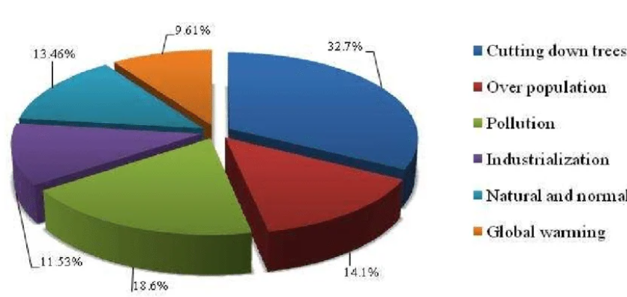
Pie chart showing the main causes of climate change

Slide 16



Guided Practice Activity
Step 1: Identify
Step 2: Plan
Step 3: Write
Read the chart carefully and note key data points
Organize your ideas into a clear structure
Draft your 5-line interpretation using learned language
Step 4: Apply Language
Step 5: Review
Use appropriate vocabulary, grammar, and transitions from previous lessons
Check your work for accuracy and clarity

Slide 17





Identify key information
Title
Read the chart title carefully to understand the main topic.
This tells you what data is being presented and helps you focus your interpretation.
Segments
Identify the largest and smallest segments or values.
These are usually the most important points to mention in your interpretation.
Patterns
Note any significant patterns or proportions in the data.
Look for interesting relationships or distributions that stand out.
Percentages
Check percentages carefully before writing.
Accurate numbers are essential for a correct interpretation.

Slide 18
How to
Structure
a Chart Report?
Introductory Statement
Main Observations
Supporting Details
Conclusion
Add comparisons and specific percentages or numbers.
Summarize the overall pattern or trend in the data.
State what the chart shows in one clear sentence.
Describe the most significant data points first.
  Focus on the largest or most important values.
  End with a general observation about the chart.
  Use comparative language to show relationships.
  Example: 'The pie chart illustrates, shows, displays...'
  The majority of..., A small percentage of..., nearly half, a significant portion,
A is greater than B, X accounts for more than , y represents the largest…
Overall, In summary, It is clear that...

Slide 19
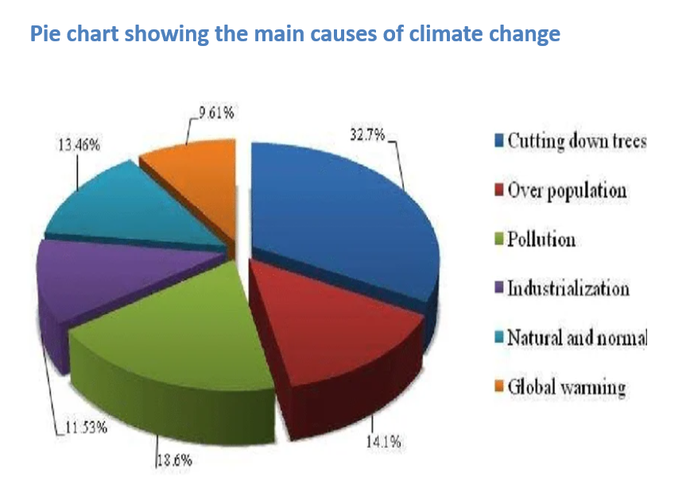
The pie chart illustrates the main causes of climate change according to a specific survey. The data shows that cutting down trees represents the largest single cause, accounting for 32.7% of the total share. In comparison, pollution is the second most significant factor at 18.6%, followed closely by overpopulation at 14.1% and natural or normal cycles at 13.46%. Meanwhile, industrialization and global warming make up the smallest portions of the chart, standing at 11.53% and 9.61% respectively. In summary, it is clear from this dataset that human activities—especially deforestation and pollution—are viewed as the dominant drivers of global climate change.

Slide 20
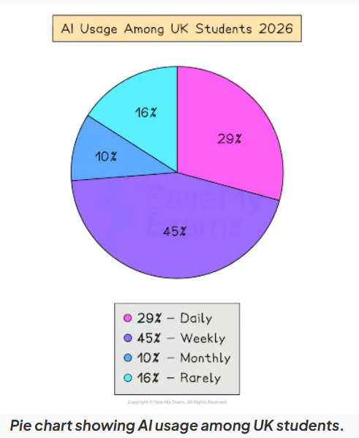

Slide 21
Student Platform Engagement Analysis
The table provides information regarding how different student age groups interact weekly with an online learning platform, alongside their final course completion rates. Comparing numbers across columns and rows, we see that teenagers spend most of the time on video lessons at 180 minutes per week, yet they achieve the lowest overall completion rate at just 45%. If we look through the table, we notice that there seems to be a significant difference between young users and older adults (aged 26–45), who spend far less time watching videos but dedicate the highest amount of time to discussion forums. It is evident from this dataset that as students get older, they spend more time participating in community discussion forums rather than just watching videos, which directly correlates with much higher academic success on the platform.
Student Age Group | Video Lessons (Weekly Minutes) | Interactive Quizzes (Weekly Minutes) | Discussion Forums (Weekly Minutes) | Final Course Completion Rate (%)
Teens (13–17) | 180 | 95 | 15 | 45%
Young Adults (18–25) | 120 | 60 | 40 | 68%
Adults (26–45) | 90 | 45 | 75 | 82%
Seniors (46+) | 110 | 30 | 80 | 78%

Slide 22



Keys to Successful Interpretation
Read Carefully
Organize Thoughts
Use Appropriate Language
Review for Clarity
Take time to understand all chart elements
Plan your structure before writing
Apply learned vocabulary and grammar accurately
Ensure clarity and logic
Follow these steps every time you interpret a chart for better results

